Slide 1

RV Institute of Technology and Management
Department of Information Science and Engineering
JP Nagar, Kothanur, Bengaluru - 560076
File Structures Laboratory- Mini Project
Contact Management System
Team Details
Samay M Shetty (1RF19IS047)
Shreyank G (1RF19IS066)

Slide 2
Agenda
Introduction
Objective and Scope
Use Case Diagram
Files Structures Concept used
Software/Hardware Requirements
Modules and Explanation
Screenshot of results
Conclusion
References

Slide 3
Introduction
Contact Management System is a Python program that can manage the list of contact information.
It contains all the required functions which include adding, viewing, deleting and updating contact lists.
The system can be accessed without the use of login information.

Slide 4
Objective and Scope
The purpose of the system is to organize the list of all available contacts such as by inputting names and contact numbers.
To build an application program to reduce the manual work for managing contact, credential, mobile and telephone.
The project is a simple GUI application that uses the Tkinter module in order to create a design view.

Slide 5
Use Case Diagram
View
Add
Delete
Search
User

Slide 6
File Structures concept used
The file structure concept used in this project is file handling.
File handling has been used to record all data.
In this project, we use the concept of file handling to add contact details, update if required, delete and even search a contact.
We can even view the list of contacts added.

Slide 7
Software/Hardware Requirements
Hardware requirement
Ram at least 128 MB.
Processor i3/i5/i7
Memory 2 GB.
Software requirement
OS : Windows 7/Windows 10/ Windows 11
Browser : Mozilla Firefox/Google Chrome/Microsoft Edge
Language : Python v3.8 or above

Slide 8
Modules and Explanation
This app mainly contains two modules in it.
View: Allows the user to view all the contact information stored in the system.
Add: It also has the functionality of adding new contacts into the system.
Delete: Users can delete contact information from the list.
Update: Allows users to modify the record details.
Search: It allows users to search details based on their phone numbers.

Slide 9
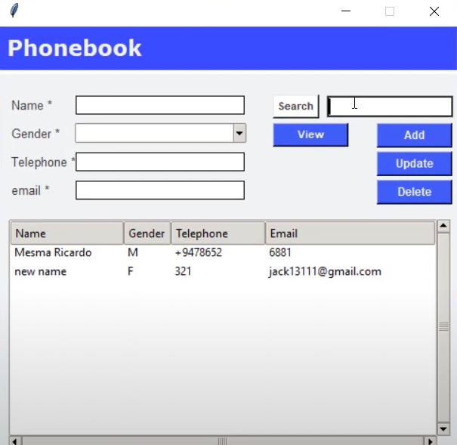
Screenshot of results
Added contacts

Slide 10
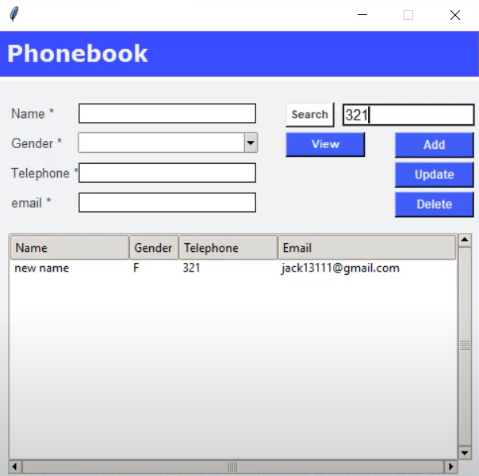
Searching a contact

Slide 11
Conclusion
In this project, the concept of file handling became very clear as it allows us to deal with records by performing operations on it.
This project contains generous amount of features, which will help a user to use their phone in a more regular way.

Slide 12
References
Michael J. Folk, Bill Zoellick, Greg Riccardi: File Structures-An Object Oriented Approach with C++, 3rd Edition, Pearson Education, 1998.
The Complete Python Course | Learn Python by Doing in 2022 - https://www.udemy.com/course/the-complete-python-course/

Slide 13
Thank You

